Slide 1
Planning and Requirements
Project Title: Vision-Based Sorting Arm

Slide 2
Presentation Outline
Project Overview
Problem Statement And Solution
Project Objectives
Importance of the Project
Methodology
Block Diagram For System
Expected Outcome
Project Timeline

Slide 3
Project Overview
Robotics has evolved through integration of computer vison and automation
Object identification based on shape and color is quite an important aspect in computer vision
Applications span across:
Industry production
Military combat
Food Processing
Agriculture
Waste Management

Slide 4
Problem Statement
Scenario: Every morning on KNUST campus waste workers are seen segregating waste manually. Despite efforts in labelling bins for easier segregation we still go the extra mile for specific sorting of waste.
Effects
Contamination
Health Hazards
Social Stigma
Landfill Overload
Lost Resources

Slide 5
Solution
To design and implement a vision-based sorting arm for waste segregation (detect and sort objects based on their shape and color)

Slide 6
Specific Objectives
To review existing literature on automated waste sorting, shape/color recognition, and robotic arm control
To design a robotic arm module with camera integration for object positioning and manipulation
To develop image processing algorithms and control logic for real-time identification and sorting
To test system functionality for accuracy, response time and reliability under varying conditions

Slide 7
Importance of the Project
Environmental: Encourages proper waste management, reduce landfill pollution
Education: Hands-on learning in robotics
Health and Safety: Remove humans from direct contact with hazardous waste materials
Economy: Higher-value for recyclables and also supports recycling industries
Technology: Literacy on technology as a nation improves

Slide 8
Methodology-Hardware Components
Component
Purpose
Raspberry Pi + Camera Module( PixyCMU Cam5 V1)[1]
Arduino(Mega 2560 Rev3)[1]
Robotic arm with servo motors(Tower Pro MG996R)[1]
Sorting bins
Power Supply
Runs OpenCV for real-time color and shape detection.(Image Processing)
Controls servo motors for arm movement
Executes picking and placing operations
Seperates containers for different waste categories
Provides necessary voltage for all components

Slide 9
Methodology-Software Components
Tool
Purpose
Arduino IDE 2.3.7
Python 3.14.3
OpenCV
SolidWorks
Serial Communication Protocol
Writing and uploading C++ code to control servo motors
Running OpenCV library for object detection
Computer Vision library for image processing and object recognition
3D modeling and design of robotic arm
Data exchange between Raspberry Pi and Arduino

Slide 10
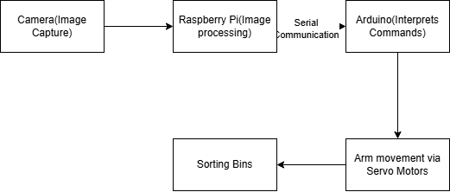
System Block Diagram

Slide 11
Expected Outcome
Working Prototype
Technical Report
User Manual
Success Criteria
Accurate detection
Reliable picking and placing mechanism
Real-time processing capability

Slide 12
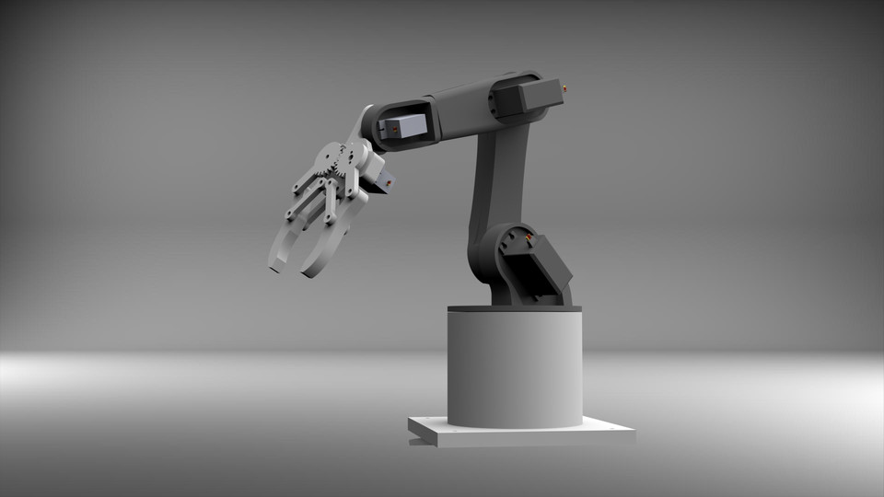

Slide 13
Proposed Timeline
Activity | Duration | Start Date | End Date
Literature Review | 2 weeks | 11/02/2026 | 25/02/0206
System Design | 2 weeks | 01/03/2026 | 14/03/2026
Component Procurement | 3 weeks | 15/03/2026 | 04/03/2026
Implementation | 4 weeks | 02/05/2026 | 30/05/2026
Testing | 3 weeks | 01/06/2026 | 21/06/2026
Report Writing | 3 weeks | 22/07/2026 | 12/08/2026

Slide 14
References
[1] M. Abdullah-Al-Noman, A. N. Eva, T. B. Yeahya, and R. Khan, "Computer vision-based robotic arm for object color, shape, and size detection," *Journal of Robotics and Control*, vol. 3, no. 2, pp. 1-7, 2022.
[2] L. Fernandes and S. B.R., "Identification and sorting of objects based on shape and colour using robotic arm," in Proc. 4th International Conference on Inventive Systems and Control (ICISC 2020), IEEE, 2020, pp. 871-876. doi: 10.1109/ICISC47916.2020.9171190.

Slide 15
Thank You🫱🏾‍🫲🏿

